Slide 1

Construction Technologies for speedy delivery of structures
Presented by:
Er. C.A. PRASAD
DIRECTOR, METEY ENGINEERING AND CONSULTANCY PVT LTD

Slide 2
HOUSING SINCE THE START

Slide 3
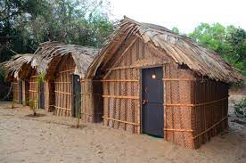
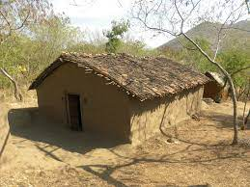


Slide 4
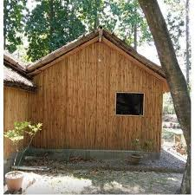
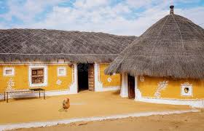

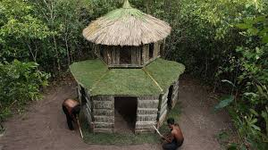

Slide 5
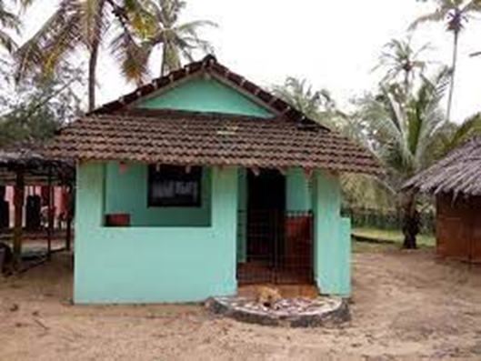


Slide 6
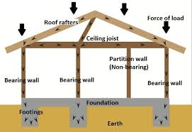
TIMBER JOIST CONSTRUCTION

Slide 7
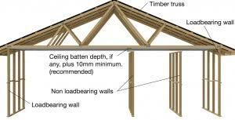
LOAD BEARING WALL WITH TIMBER ROOF TRUSS

Slide 8
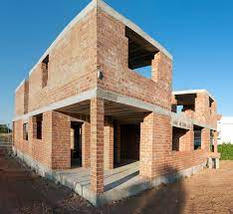
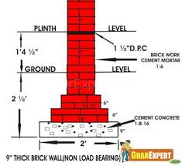
LOAD BEARING MASONRY CONSTRUCTION

Slide 9
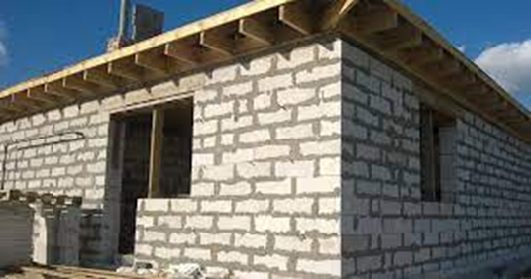
LOAD BEARING MASONRY CONSTRUCTION

Slide 10
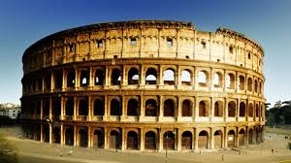
LOAD BEARING MASONRY CONSTRUCTION

Slide 11
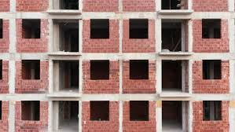
RCC FRAME - CONVENTIONAL CONSTRUCTION

Slide 12
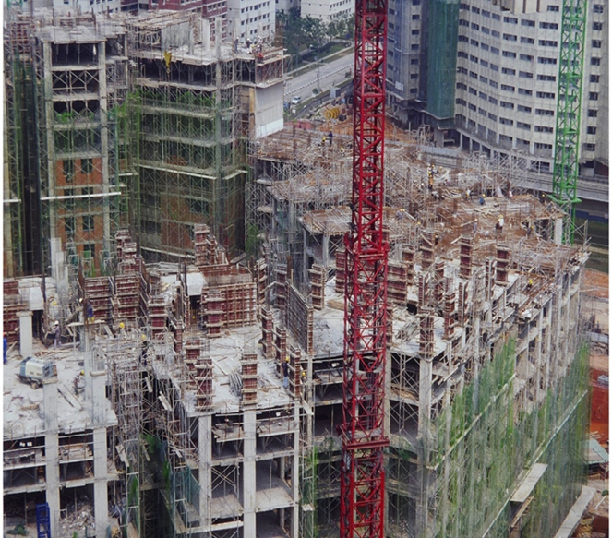
CAST INSITU SYSTEM

Slide 13
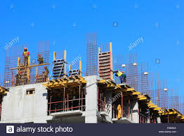

Slide 14
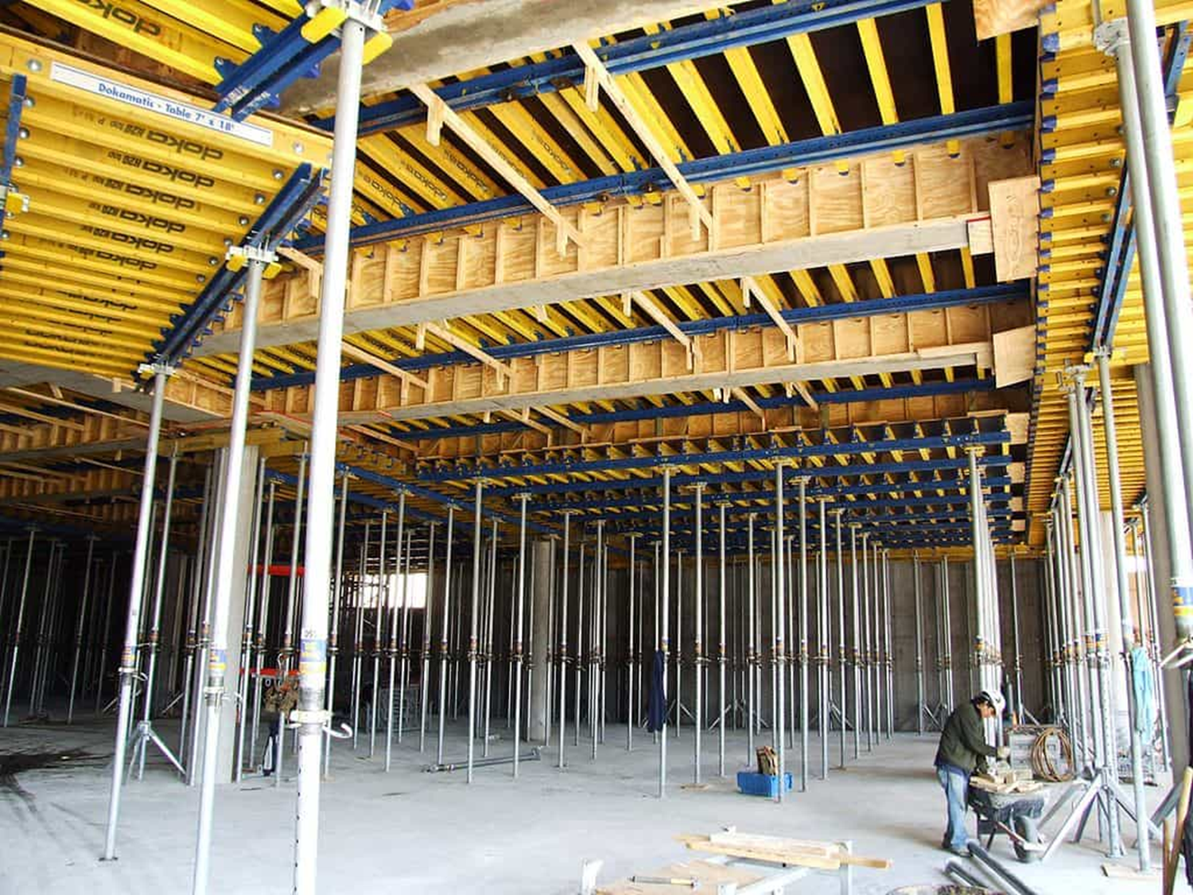

Slide 15
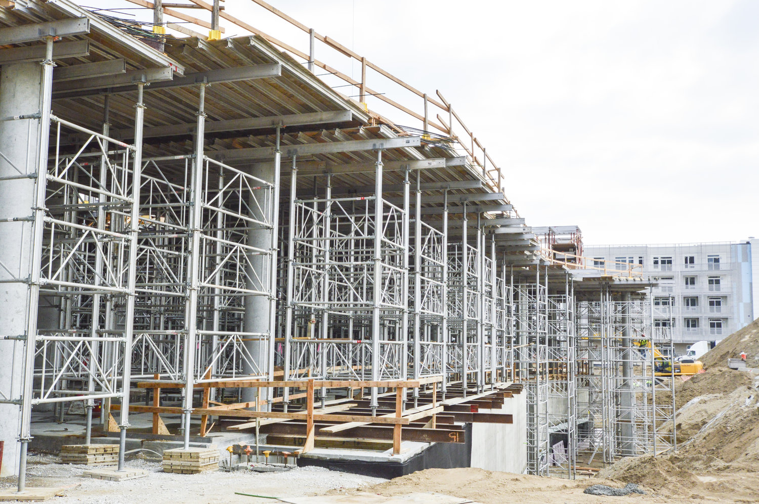

Slide 16
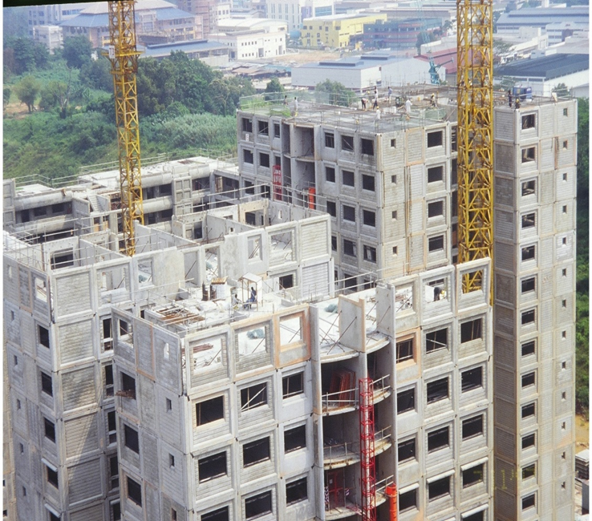
PRECAST SYSTEM

Slide 17
Issues in construction system
Conventional construction :
Labour intensive
Heavy formwork intensive type of construction
Time consuming for shuttering and deshuttering
Skilled labour diminishing day by day
Accommodation to the labour at site is a problem

Slide 18
TIME
Time saving in construction has been happening through advancement in construction technology in Form work (Slip form and Jump form), Concrete pumping, Lifting Technology and various other Plant and Machinery related to construction field, followed by safety as prime importance
Further advancement in time saving as well as to meet the non availability of skilled labour led to CONSTRUCTION TECHNOLOGIES.

Slide 19
Different types of construction technologies for high rise structures for speedy delivery
Shear wall / Monolithic construction using aluminum shuttering
Insulated wall panel construction using shotcreteing of concrete
Light gauge steel or cold formed steel construction
Precast/Prefabricated construction using concrete/steel
Composite construction

Slide 20
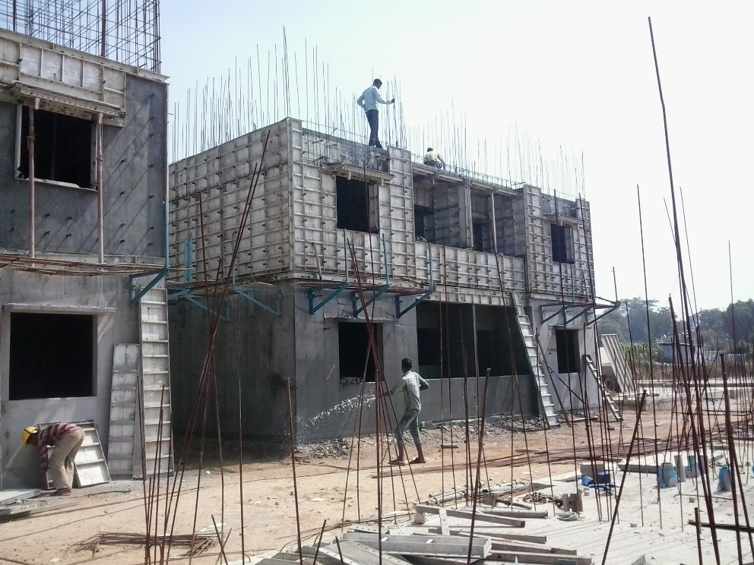
SHEAR WALL / MONOLITHIC CONSTRUCTION USING ALUMINUM SHUTTERING
Methodology:
The elements like walls, beams and slabs made of RCC are cast together at one go by using aluminum form work. Panels of 2’(0.6m) wide X 10’(3m), floor height are connected together with connectors.
Merits:
Construction speeds can be achieved faster due to light weight of forms and less labor required for carrying and erection of the form work.
Quality of finish achieved is very good to receive painting directly without plaster.
Formwork components are durable and can be used for 100 repetitions.
5 to 7 days cycle is easily achieved in most of the constructions and construction time for overall project is dramatically reduced.

Slide 21
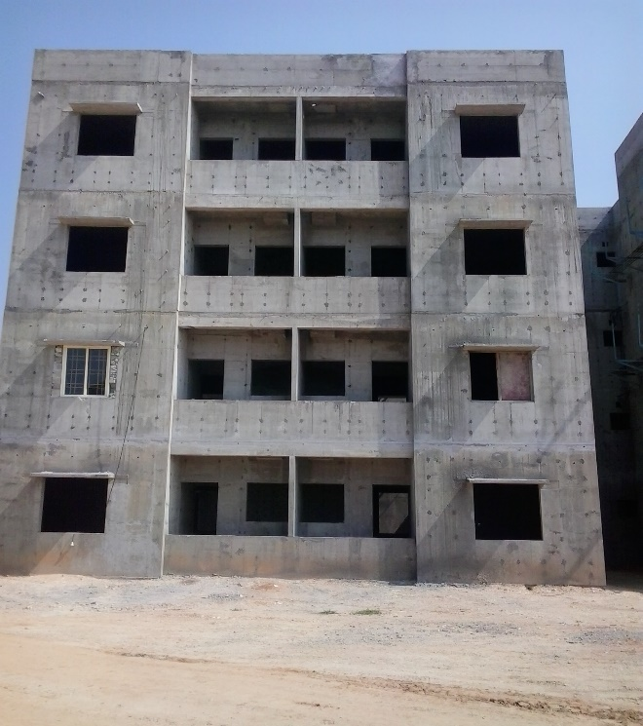
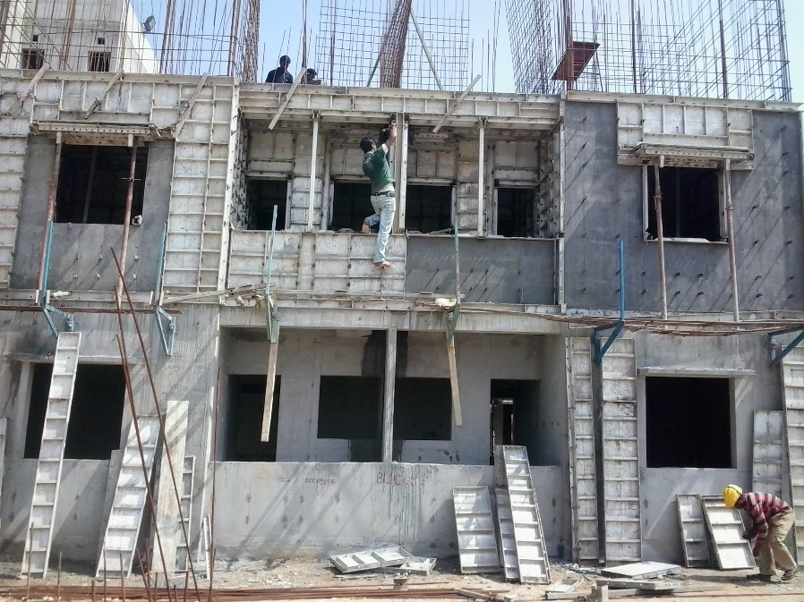
Demerits:
Initial investment on formwork is higher at the rate of Rs.10,000/sqm
About 50 repetitions are easy to achieve and there after maintenance is required to be done for correctness of shape such that another 50 repetitions could be completed
No. of sets of formwork to be decided based on time of construction and the repetitions to be achieved.

Slide 22
EWS HOUSING CONSTRUCTION IN A.P using
MONOLITHIC TYPE OF CONSTRUCTION with Aluminum formwork

Slide 26
VISAKHAPATNAM, VIZIANAGARAM AND SRIKAKULAM DISTRICTS

Slide 27
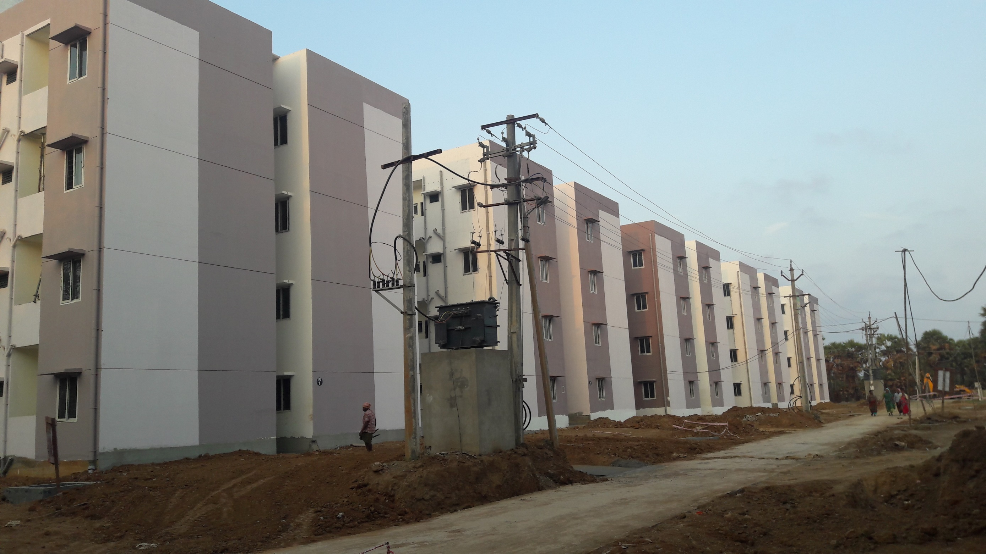

Slide 28
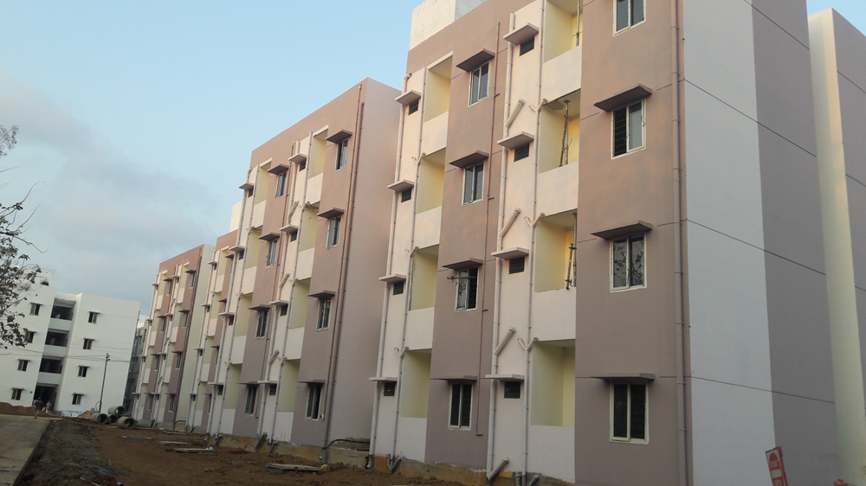

Slide 29
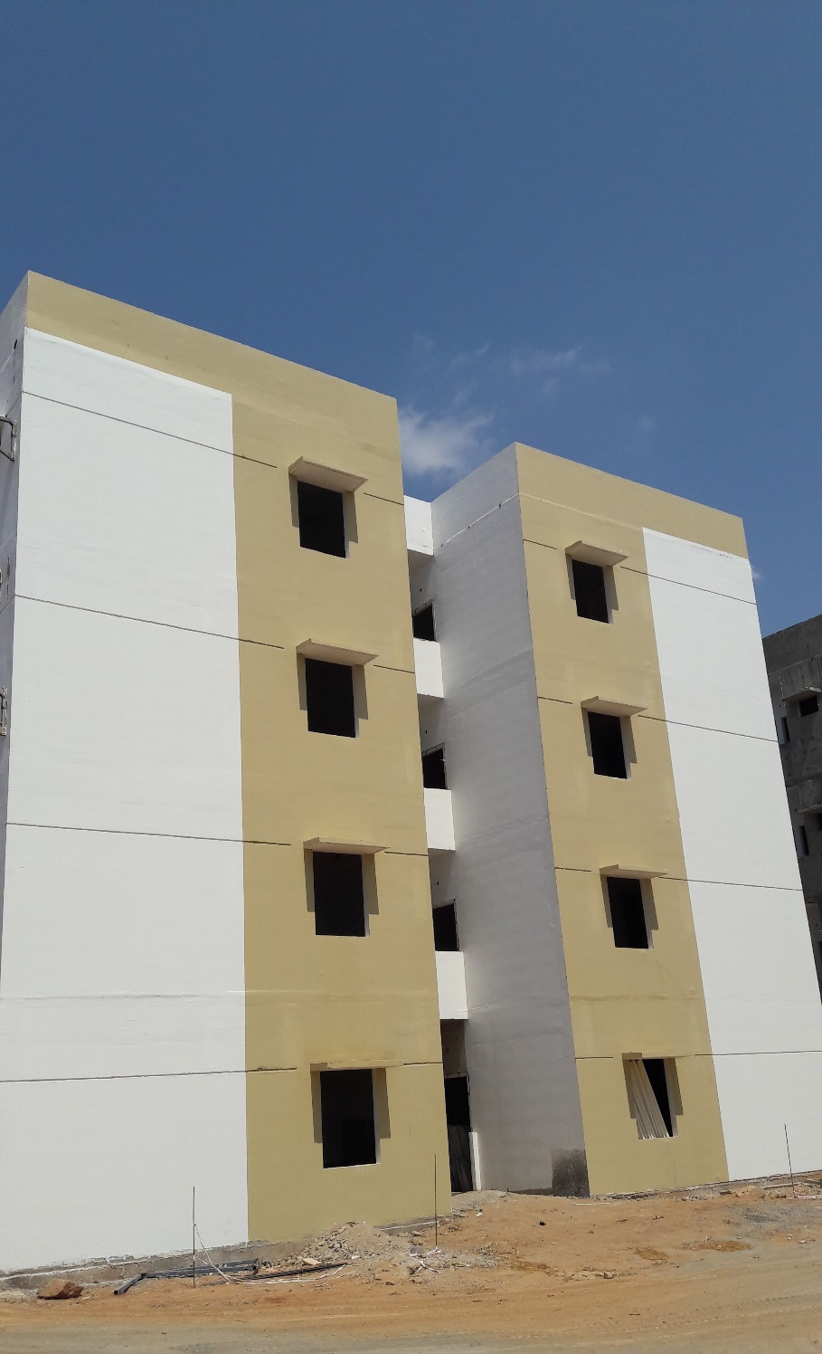
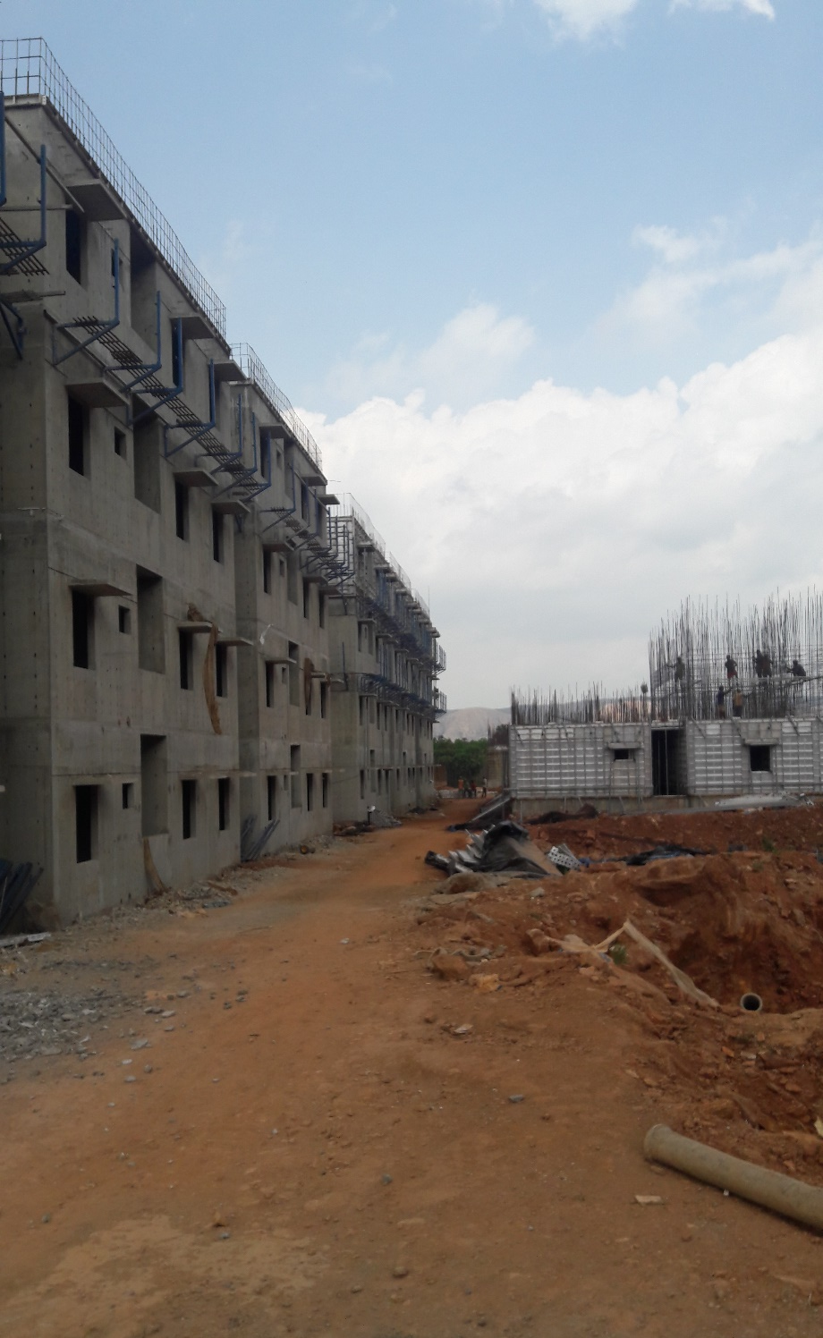
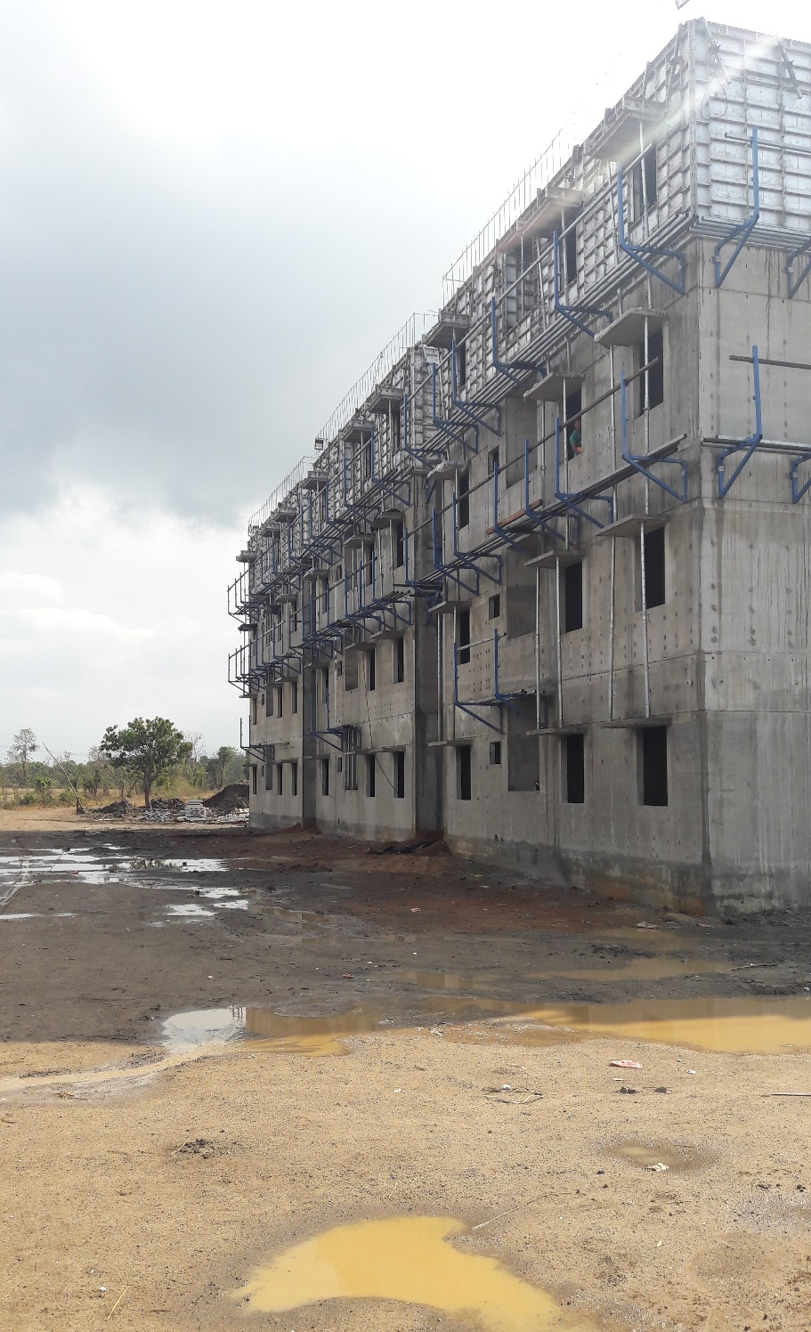

Slide 30
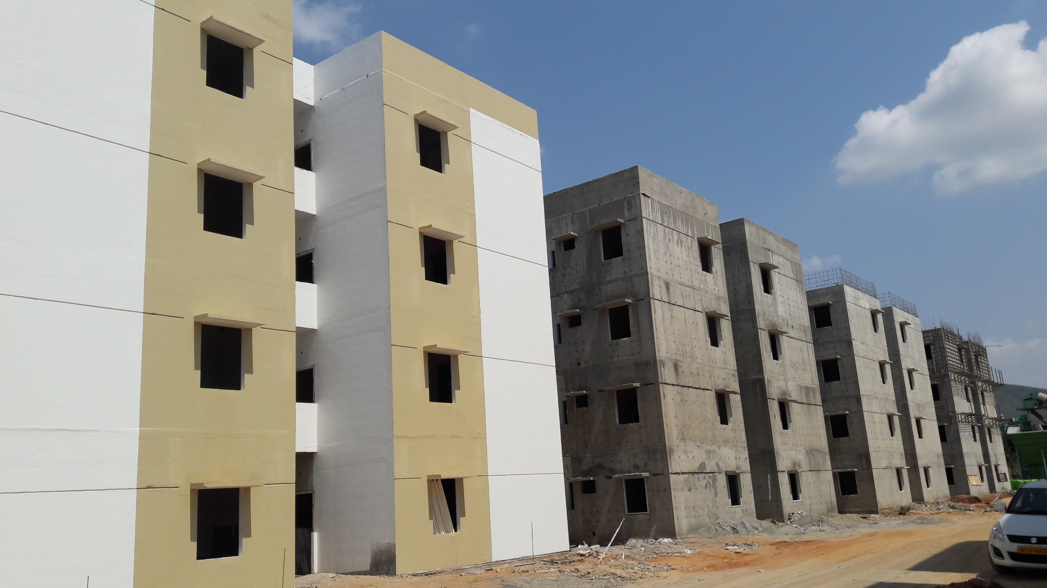

Slide 31
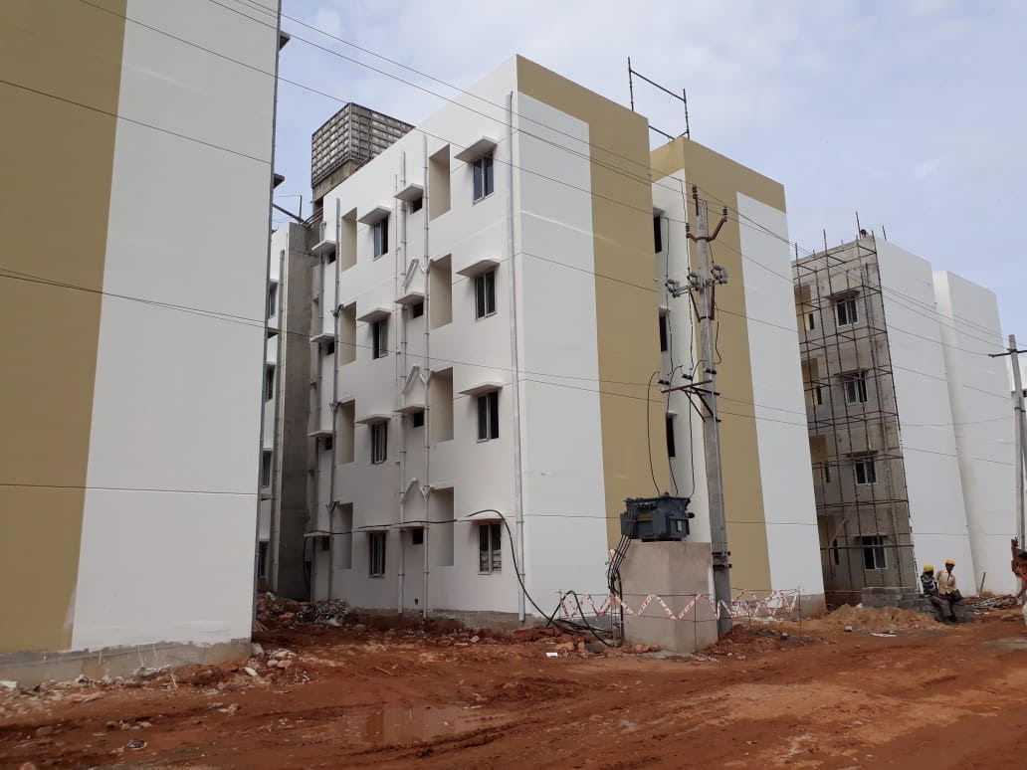

Slide 32
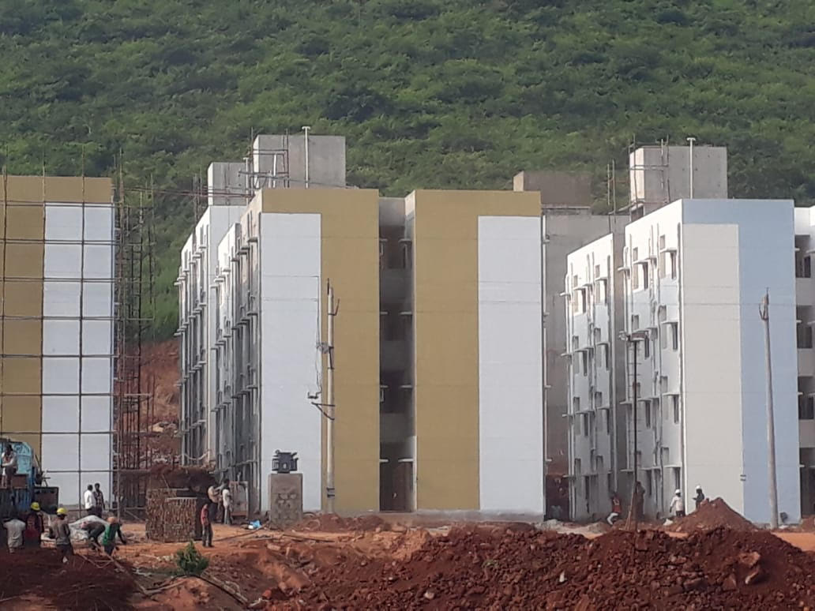

Slide 33
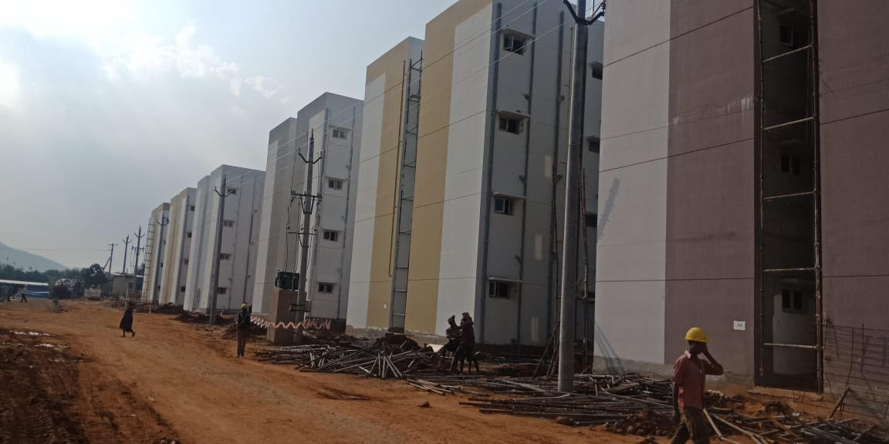

Slide 34
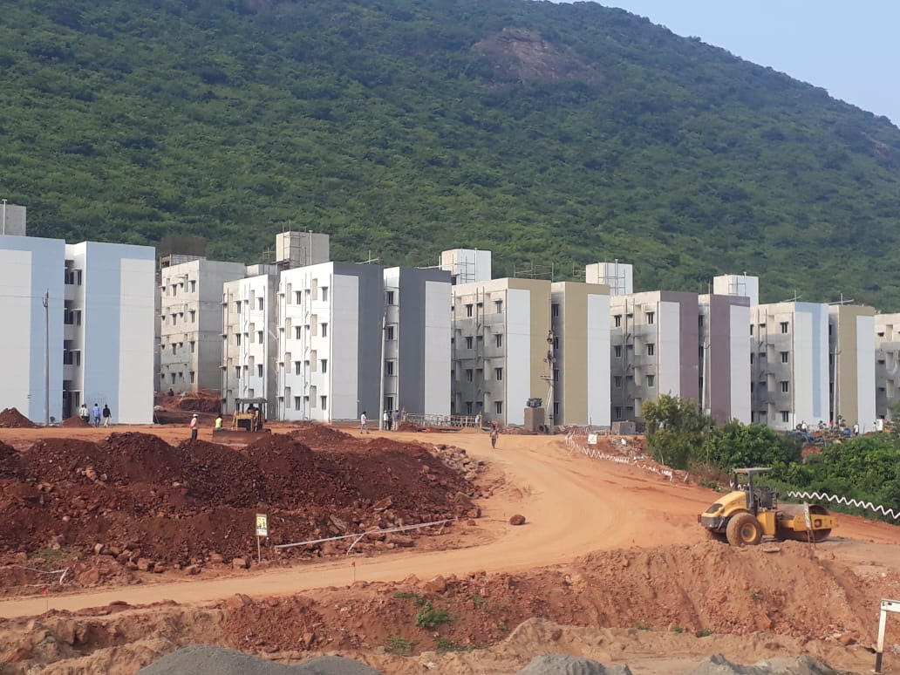

Slide 35
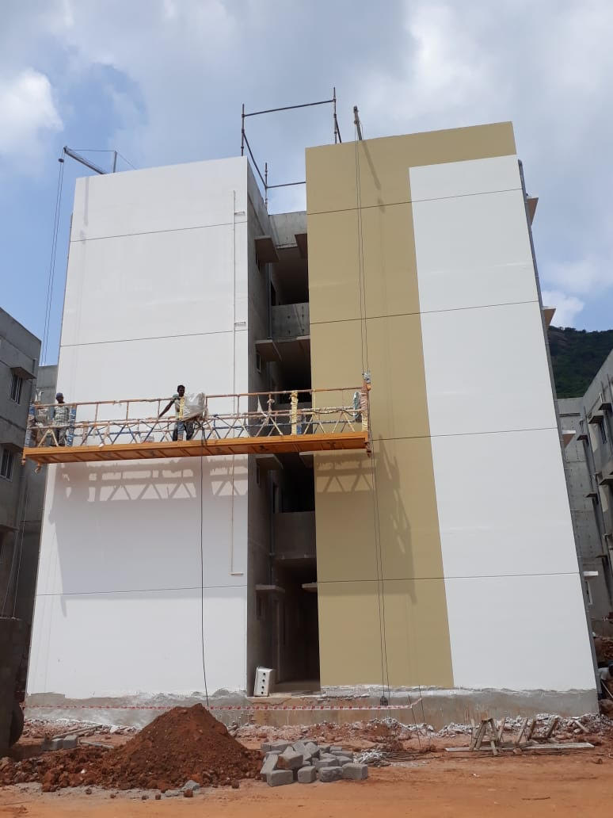

Slide 36
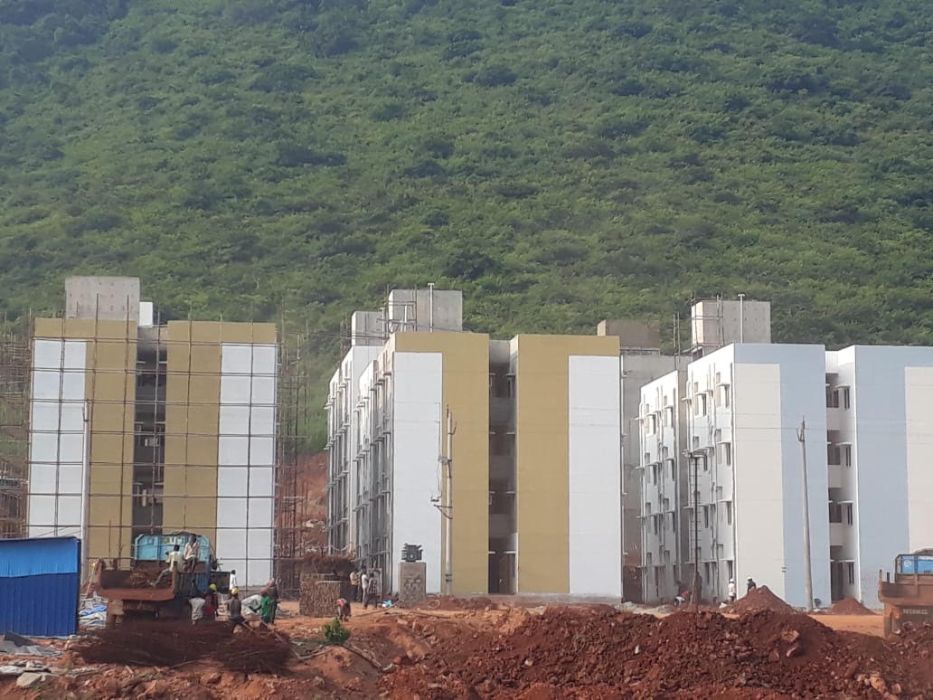

Slide 37
AMARAVATHI

Slide 38
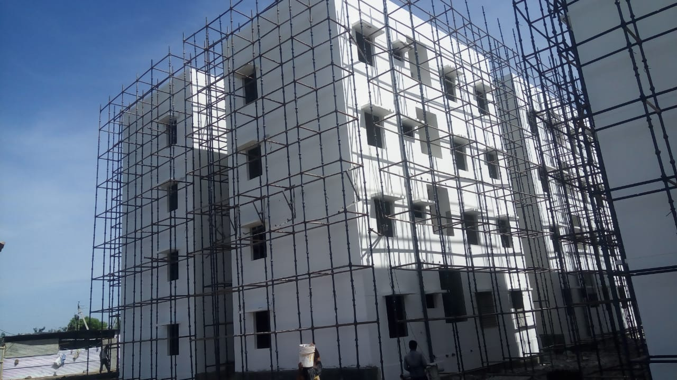

Slide 39
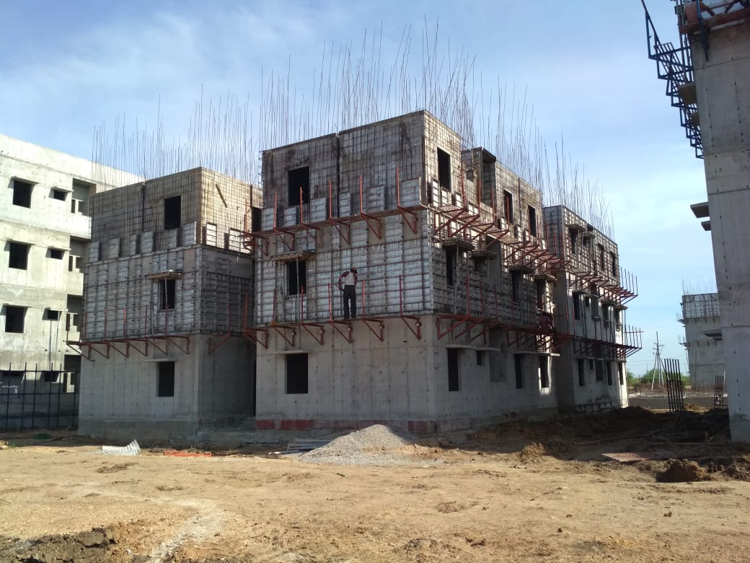

Slide 40
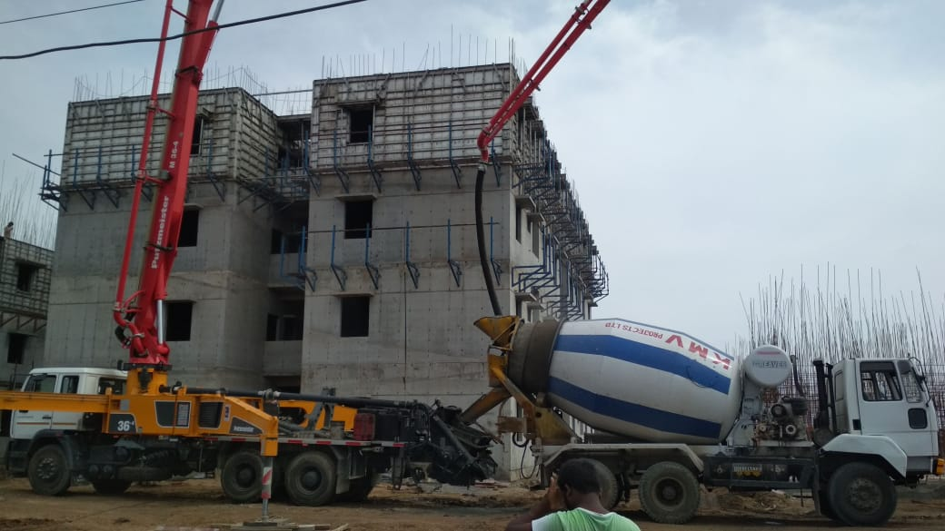

Slide 41
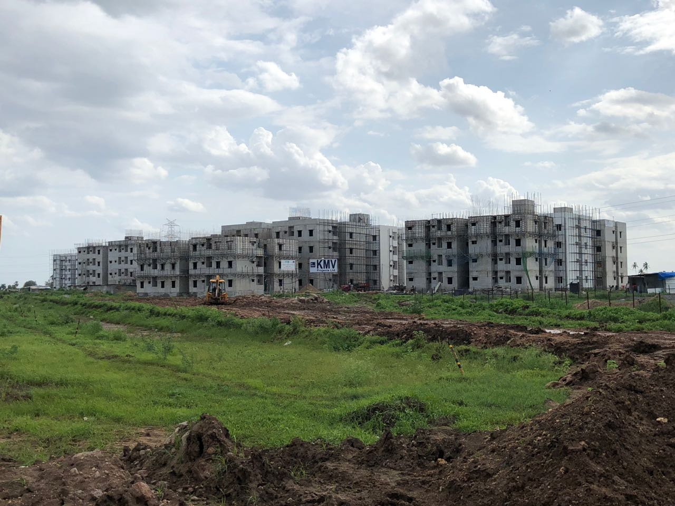

Slide 42
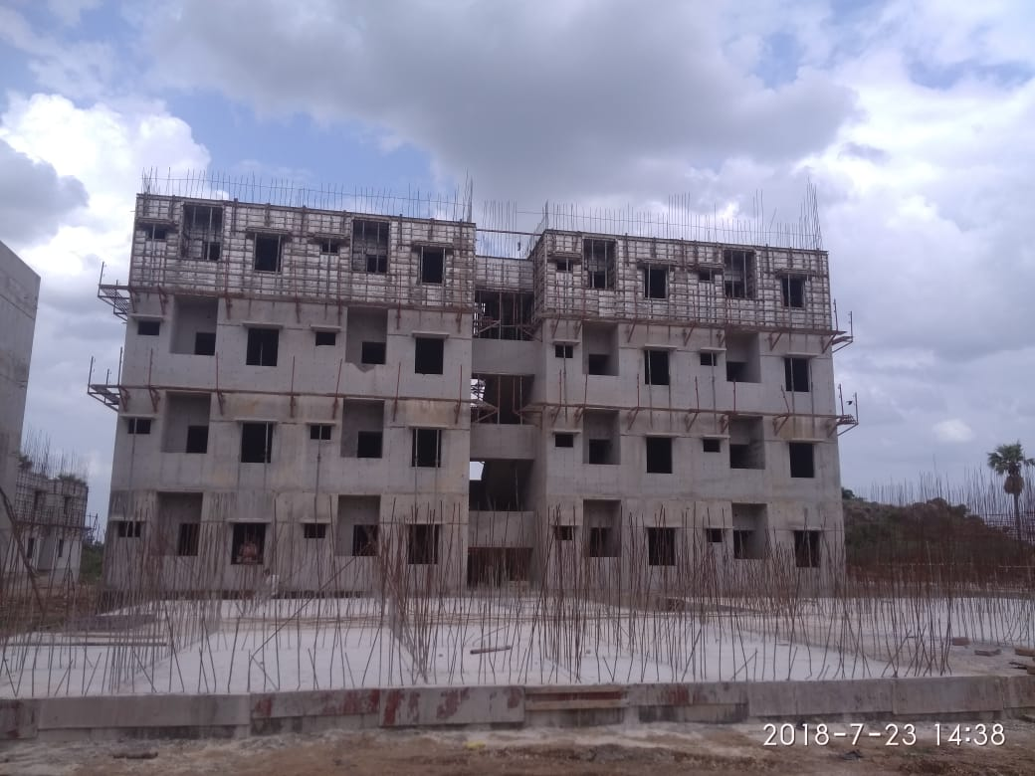

Slide 43
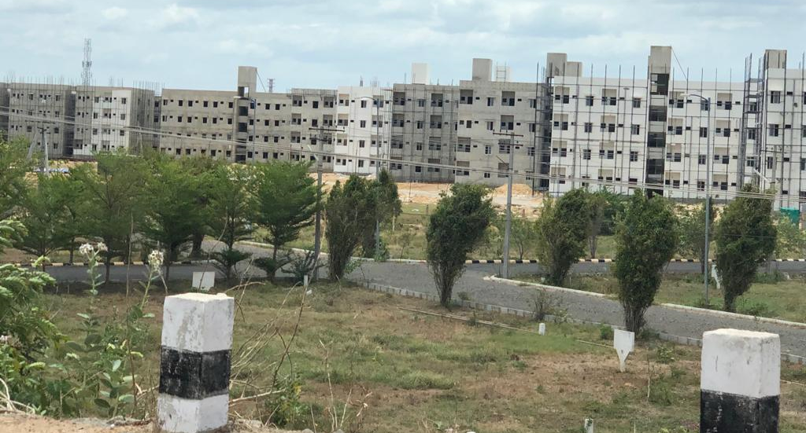

Slide 44
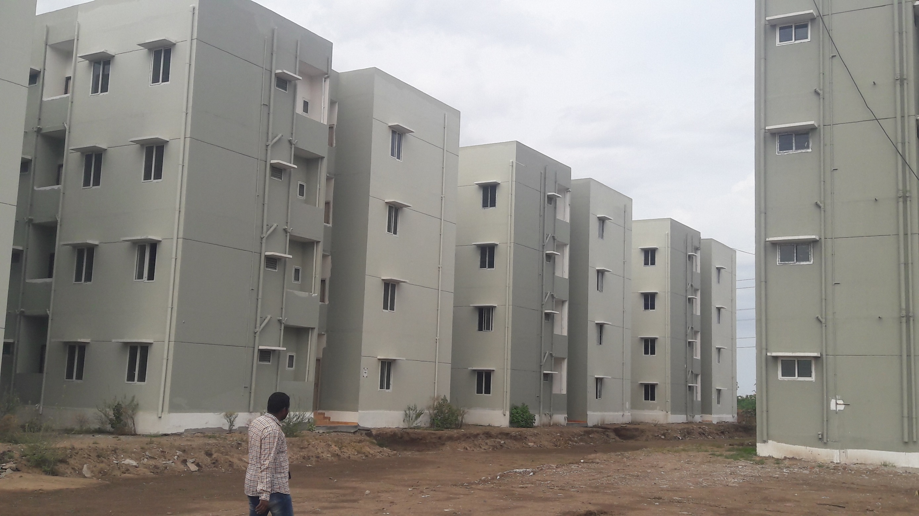

Slide 45
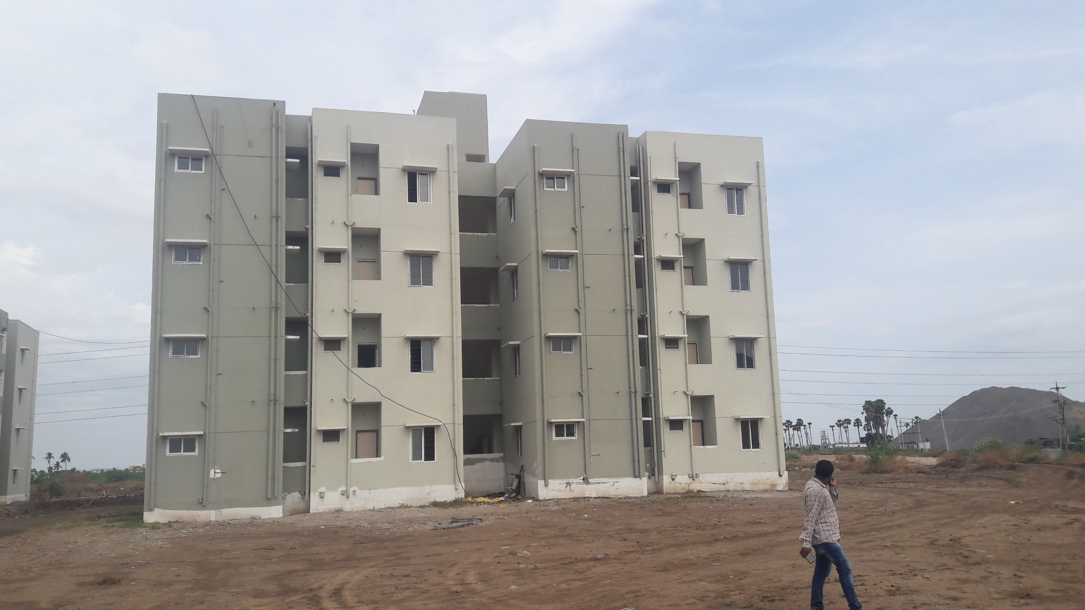

Slide 46
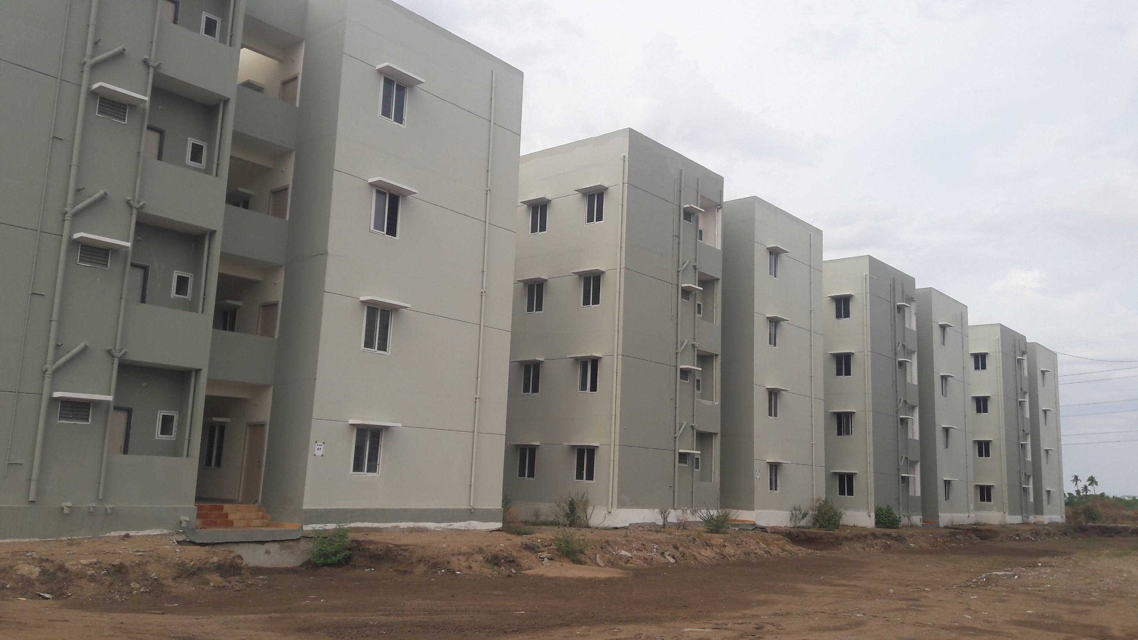

Slide 48
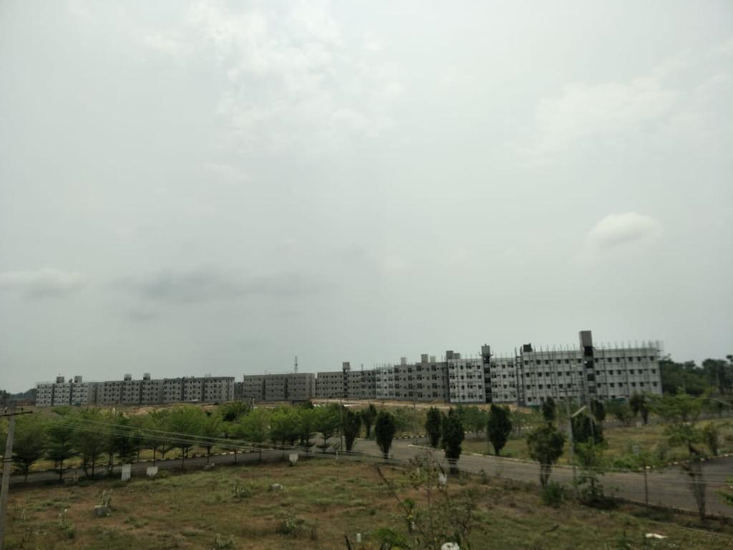

Slide 49
INSULATED WALL CONSTRUCTION USING SHOTCRETE

Slide 50
Insulated wall panel construction using shotcreteing of concrete.
Methodology:
System is conceived with insulated wall and roof panels of corrugated extruded polystyrene(EPS), which consists of zinc coated square mesh on either sides of it connected by a shear connectors
The panels are coated with concrete through shotcreting machines
Merits:
Light weight, seismic resistant, sound and thermal resistant
EPS will reduce the Air conditioning loads too

Slide 51
Demerits:
Shotcreting means insitu work and needs to be closely monitored and inspected

Slide 52
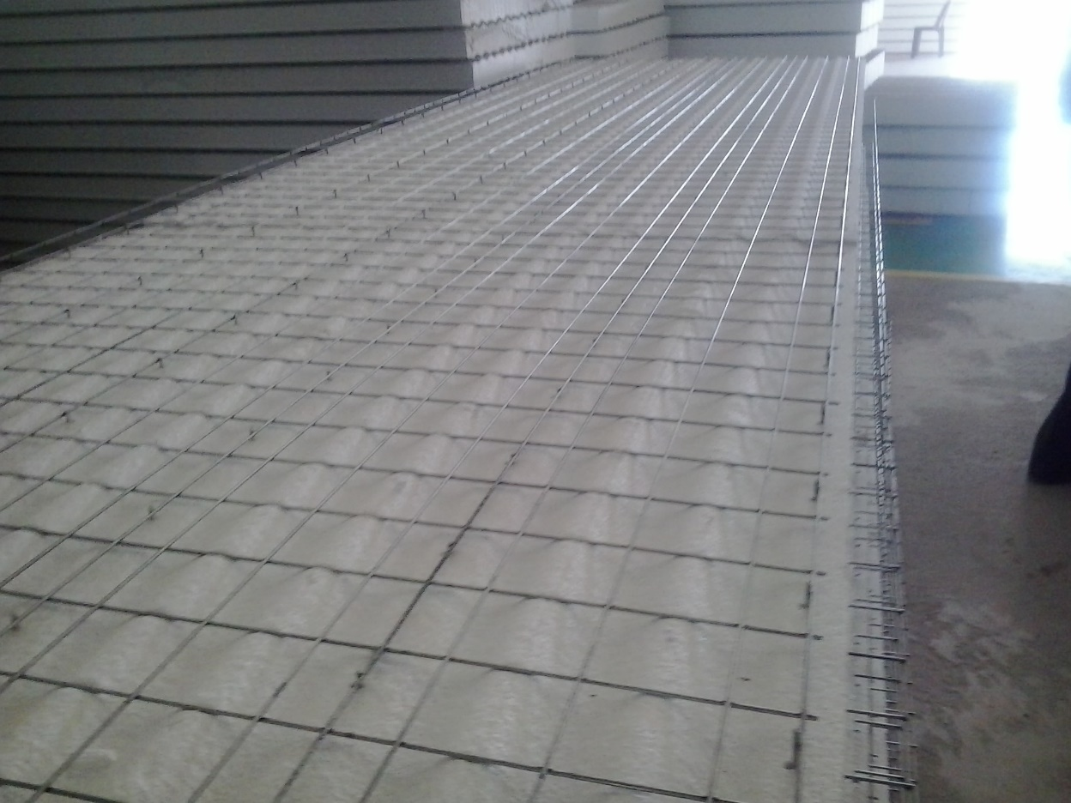
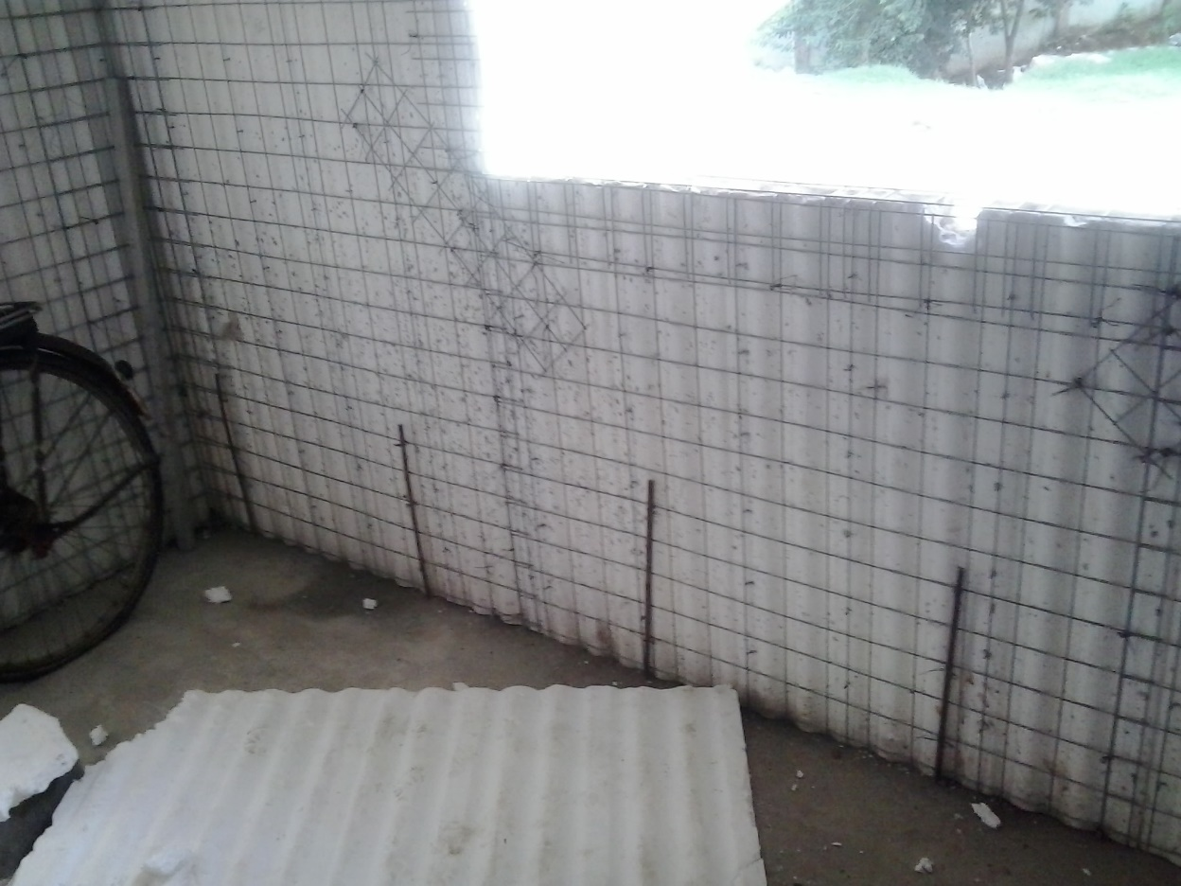
Images of buildings constructed at ANGUL Orissa for JSPL using EPS Panel technology:

Slide 53
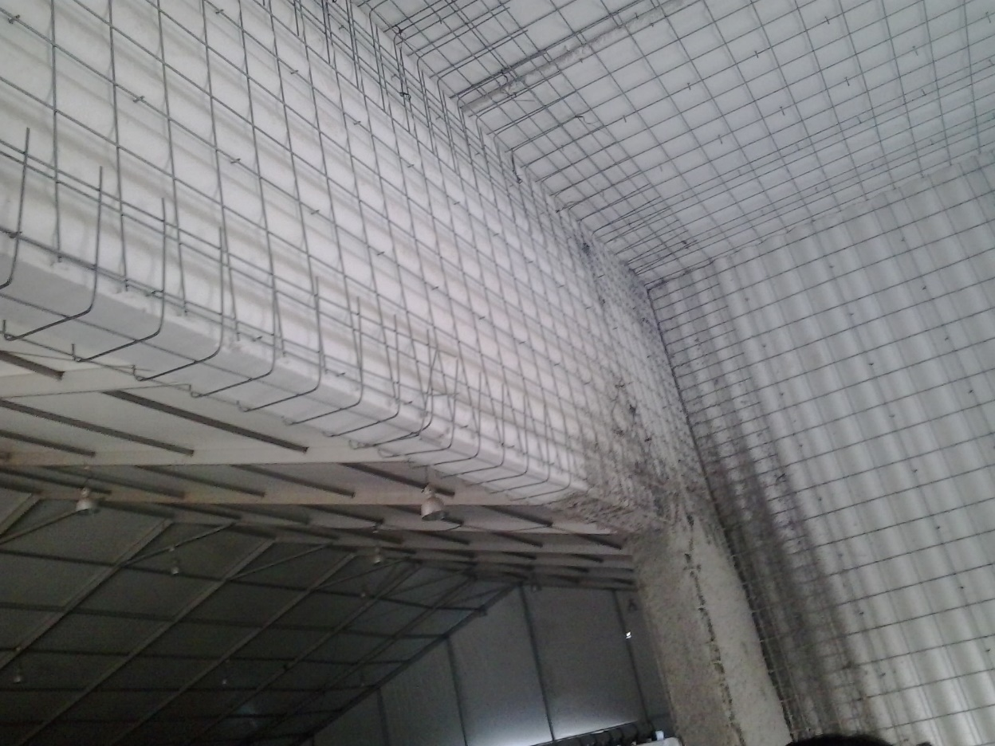
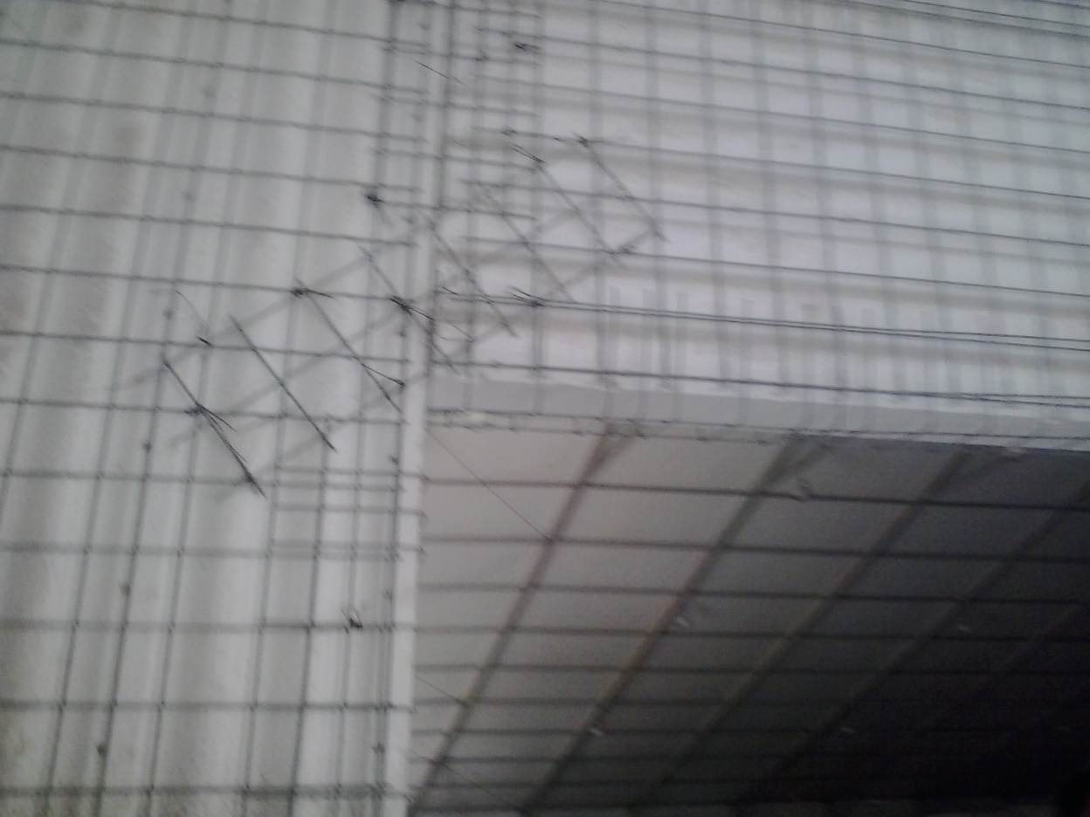
Images of buildings constructed at ANGUL Orissa for JSPL using EPS Panel technology:

Slide 54
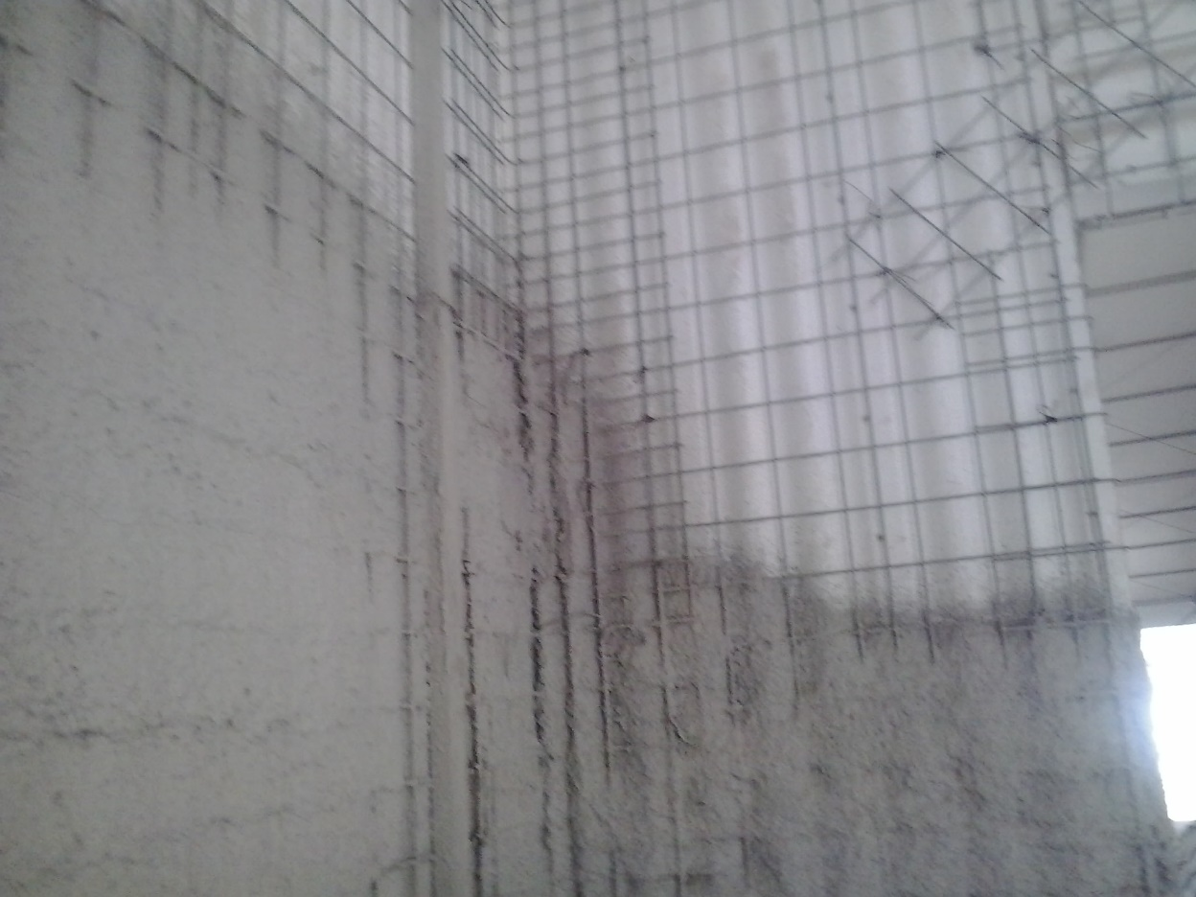
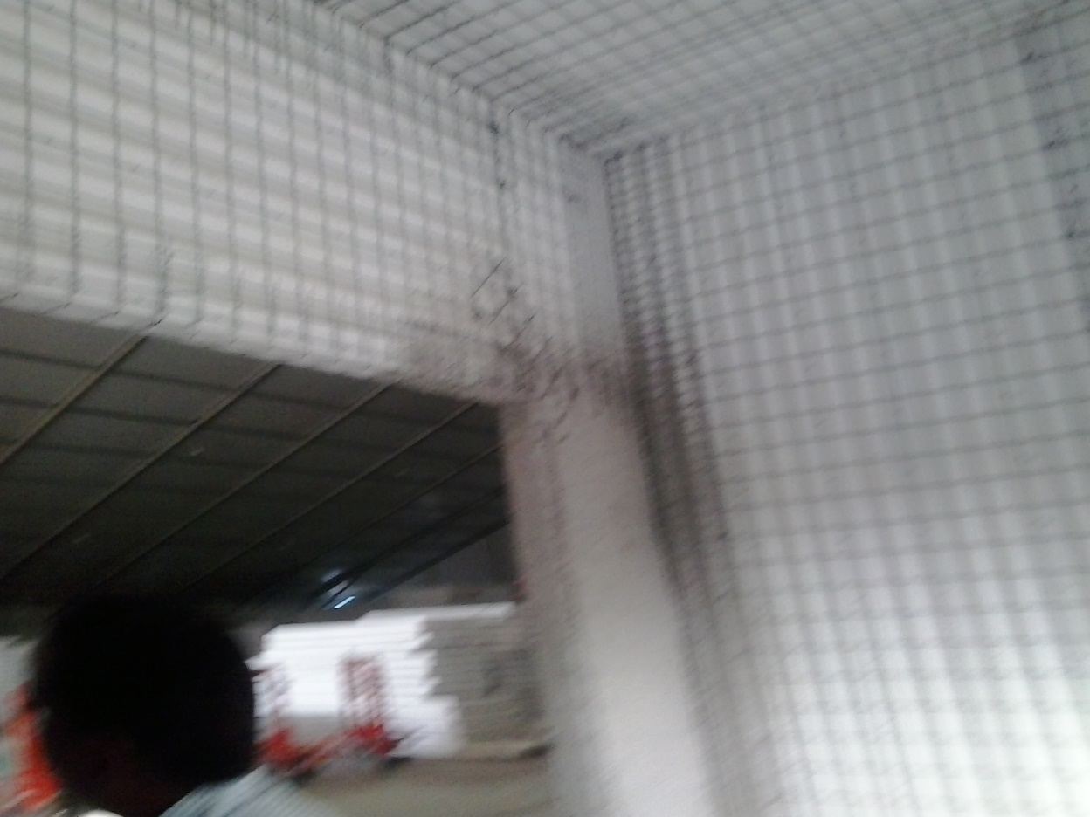
Images of buildings constructed at ANGUL Orissa for JSPL using EPS Panel technology:

Slide 55
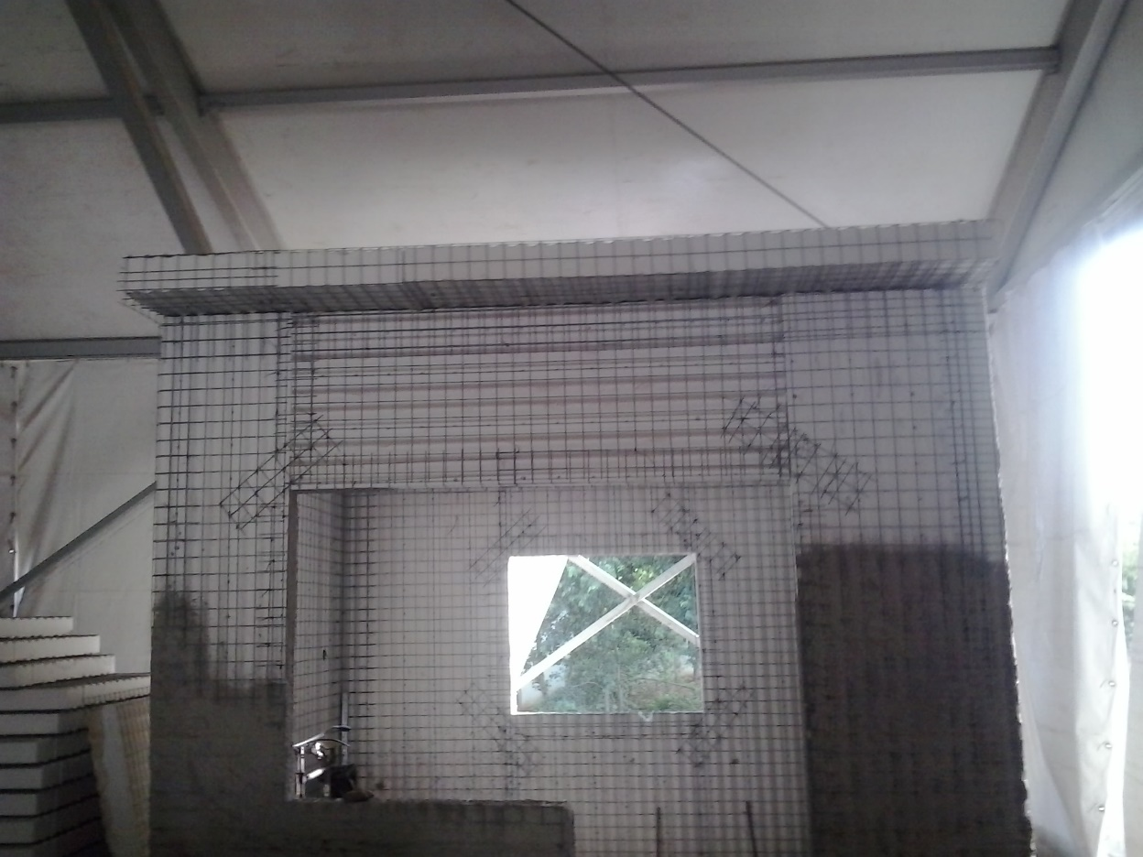

Images of buildings constructed at ANGUL Orissa for JSPL using EPS Panel technology:

Slide 56


Images of buildings constructed at ANGUL Orissa for JSPL using EPS Panel technology:

Slide 57


Images of buildings constructed at ANGUL Orissa for JSPL using EPS Panel technology:

Slide 58


Images of buildings constructed at ANGUL Orissa for JSPL using EPS Panel technology:

Slide 59


Images of buildings constructed at ANGUL Orissa for JSPL using EPS Panel technology:

Slide 60


Images of buildings constructed at ANGUL Orissa for JSPL using EPS Panel technology:

Slide 61


Images of buildings constructed at ANGUL Orissa for JSPL using EPS Panel technology:

Slide 62


Images of buildings constructed at ANGUL Orissa for JSPL using EPS Panel technology:

Slide 63


Images of buildings constructed at ANGUL Orissa for JSPL using EPS Panel technology:

Slide 64
EWS BUILDINGS AT NTR PETA, SRIKAKULAM WITH EPS TECHNOLOGY
Presented by:
C.A Prasad
Director, METEY Engineering and Consultancy Pvt Ltd,
Hyderabad

Slide 65

Architectural plan:

Slide 66
Light gauge steel or cold formed steel construction

Slide 67
Light gauge steel or cold formed steel construction.
Methodology:
Light weight cold formed steel sections for speedy low rise building construction.
Gauge thickness from 0.7-2.0mm.
These could be used in industrial townships, residential and commercial buildings, hospitals and schools etc.,
External and internal walls are to be covered with plaster boards duly putting the rock wool in between them, which will give the thermal insulation.

Slide 68
Merits:
Light weight, Seismic resistance, Thermal and acoustic insulation. With rock wool insulation inside, Air conditioning loads will be lesser
Demerits:
Spacing of studs and joists will have an effect on internal and external planning of structure
Plaster boards are required to be fire resistant and should be durable against the external environment, thereby, its cost is prohibitive compared to conventional systems

Slide 69
COMPOSITE CONSTRUCTION

Slide 70

Composite construction.
Methodology:
Structural Steel columns and beams with Deck slab + Concrete or Insitu concrete with shuttering is a method of construction
Steel columns could be encased to get additional strength in addition to steel.
Merits:
Very faster construction
Concrete encasement makes the steel fire resistant and protects from corrosion/ durability

Slide 71


Demerits:
Cost is higher by about 20 to 30% compared to RCC type of construction
Fire resistant paint to be applied to structural steel elements is very prohibitive

Slide 72


Slide 73


Slide 74


Slide 75





Slide 76
Precast/Prefabricated construction using concrete/steel

Slide 77
PRECAST ABROAD

Slide 78


Buildings from Middle east

Slide 79


Buildings from Middle east

Slide 80


Buildings from Middle east

Slide 81
PRECAST PROJECTS IN
INDIA

Slide 82
Santushti Homes at Bhiwadi
250 affordable homes
G+3 Storied 3 Blocks
Load bearing Precast walls
Precast Solid Slabs (room size)
Site Based Precast Plant

Slide 83


Slide 84


Slide 85


Slide 86
PRECAST SET UP SCALE VS COST
 | Parameter | Units | Case-1 | Case-2 | Case-3
Scale | Built up area required | mn.sft | 1 | 2 | 3
Investment | Precast plant | Rs cr | 13 | 17 | 22
 | Additional site machinery | Rs cr | 3 | 4 | 4
 | Any other major capex required | Rs cr | 2 | 3 | 4
Total |  |  | 18 | 24 | 30
Operating costs in precast | Operating cost of plant | Rs/sft
 | Material costs | Rs/sft
 | Total cost of production | Rs/sft
 | Transportation costs | Rs/sft
 | Labour costs | Rs/sft
 | Operating cost of onsite equipment | Rs/sft
 | Total cost of construction | Rs/sft | 1000 | 950 | 900
Costs in conventional construction | Material costs | Rs/sft
 | Operating machinery | Rs/sft
 | Labour costs | Rs/sft
 | Total cost of construction | Rs/sft | 1200 | 1200 | 1200
Labour | Skilled labour required | no. | 40 | 40 | 40
 | Unskilled labour required | no. | 20 | 20 | 20
Time | Time of construction using precast | days | 12 to 15 months | 15 to 18 months | 20 to 24 months
 | Time of construction using conventional | days | 36 months | 48 months | 60 months
 | Assumptions:
 | Unit size | 500 sft
 | Design | Simple
 | Configuration | G+4

Slide 87
PRECAST DEVELOPMENT
AND PRECAST SET UP OF
INDUSTRIES IN INDIA

Slide 88



Slide 89


Slide 90


Slide 91


Slide 92
Precast Slabs

Slide 93
Precast Beam & Girders

Slide 94
Precast Columns

Slide 95


Slide 96


Slide 97
PRECAST FLOORING SYSTEMS

Slide 98
PRESTRESSED PRECAST
HOLLOWCORE SLABS

Slide 99


Slide 100


Slide 101

Cross Sectional Dimensions

Slide 102


Slide 103


Slide 104


Slide 105
Prestressed composite slab

Slide 106


Slide 107


Slide 108



Slide 109
PRECAST
AND
CAST INSITU SLABS

Slide 110
In this type, the precast concrete plank is of minimum 50 mm thickness with integrated structural required bottom reinforcement and special steel lattice girders. After erection of the plank the slab top reinforcement is placed and in-situ concrete is pored. Following sufficient curing (final stage) the plank and the in-situ concrete jointly act as a traditional monolithic concrete slab, having same structural characteristics and quality as a regular concrete in-situ slab with the same thickness. There is no need for redesign or re-approval of the supporting and planking structure.

Slide 111
Benefits:
100% elimination of slab formwork
100% elimination of soffit plaster work.
50 to 75% reduction of slab propping work.
50 to 75% reduction of slab reinforcement work.
50 to 60% reduction of slab concreting work.
Standard Properties;
Concrete of grades 25 to 60 MPa can be used.
Maximum length of the slab is 10 metres (upto 14 metres)
Maximum width 2.5 metres (upto 4 metres)
Minimum thickness 50 mm
Soffit surface is smooth, cast against polished steel moulds.

Slide 112


Slide 113

Erection of Precast Plank
Notes:
Erection of Precast Plank

Slide 114

Slab form work is eliminated and the requirement to propping is reduced considerably

Slide 115

The precast plank is providing an unmatched smooth and leveled soffit surface. Only the joints at every 2.5m to 4m have to be levelled with filler before final finishing. Soffit plaster work is not required

Slide 116

Precast System for Housing
Wall-Frame System :
Hollow-core Slab floor
Exterior façade (Non-load-bearing/ Lateral load resist)
Stairs and Lift Core
Non-load bearing Internal Walls
Gravity + Lateral Load-bearing Wall

Slide 117
PRECAST
BOUNDARY WALLS

Slide 118


Slide 119


Slide 120


Slide 121


Slide 122


Slide 123


Slide 124


Slide 125


Slide 126


Slide 127


Slide 128
PRECAST
WALL
PANELS

Slide 129
WALL PANELS
Wall Panels could be precast as two types, viz.,
1) To full thickness as one panel, or
2) Two leaves as a double precast concrete panel of typically 2 x 50 – 100 mm thickness with integrated structural reinforcement and special lattice girders.
In the case of a first system, the wall panels would be cast horizontally on a flat bed made of steel mould, and after sufficient steam curing the bed is lifted to a 60⁰ angle then is carried away by gantry girders to one end for loading on to a truck and further to precast yard or site.
This could also be cast in the vertical position with number of moulds and after sufficient curing can be lifted off and stored in a precast yard for further curing and eventual transportation to the site.

Slide 130

Cladding panels are defined as non-load bearing architectural panels, which only fulfil an enclosing and decorative function in the façade. The combination of finish and shape contributes to the architectural expression and finished appearance of the structure.

Slide 131
EXAMPLES IN India precast buildings

Slide 132

WTC-WORLD TRADE CENTRE, PUNE
Built up area :16.5 Lakh Sq.Ft
Total No of Floors: Basement+Podium+10 Floor

Slide 133

BDA Project
Bangalore Development Authority (BDA) B+S+18 floor housing project Doddabanahalli Bangalore
B+S+18 FLOOR HOUSING PROJECT, DODDABANAHALLI, BANGALORE
M/s. B.G.Shirke Construction Technology Pvt Limited, Pune built the structure using Prefab technology

Slide 134

Office Building in Hyderabad:
Stilts- 2no’s + G +4 ; 1,65,000 sft
Delivered in 4.5 months

Slide 135

Hospital Building:
G+4 – 1,20,000 sft : Built in 4 months
Precast elements used are, viz.,
Precast Prestressed Hollow core slabs,
Prestressed beams,
Precast Retaining walls, Precast Stairs,
Precast Lift walls,
Precast Architectural elements,
Precast ducts

Slide 136

Industrial Building in Hyderabad
Cadbury’s project- 2,20,000 sft
Composite Construction: Steel columns and Beams + Precast Hollow core slabs
Delivered in 5 months

Slide 137
Few of the projects carried out by
VME Group, Chennai

Slide 138


D.R.D.O, CABS HANGER & OFFICES BUILDINGS, BANGALORE.

Slide 139


NOVOTEL IBIS COMBO HOTEL, CHENNAI.

Slide 140


KHIVRAJ MOTORS – CAR SHOWROOM, CHENNAI

Slide 141


CHENNAI SILKS SHOWROOM, TIRUNELVELI

Slide 142


OFFICE BUILDING – GUINDY, CHENNAI

Slide 143


LAKESIDE, CHENNAI

Slide 144
Few of the projects carried out by TEEMAGE, Coimbatore

Slide 145

M/s TSM Canteen Block
Built-up Area : 13,500 Sq.Ft
Scope : Beams, Columns, Hollow core slabs, Wall panels, Solid Slabs and Staircase
Time: 38 days

Slide 146

M/s. Rotary School, Tirupur, Tamilnadu
Duration : 28 Days
Built-up Area : 19,000 Sq.Ft
Scope : Beams, Columns, Hollow core slabs, Wall panels, Solid Slabs and Staircase

Slide 147

M/s. SCM Silks (P) Ltd : Tirupur, Tamil Nadu
Duration : 30 Days
Built-up Area : 52,300 Sq.Ft
Scope : Beams, columns, Hollow core slabs, Wall panels and staircase

Slide 148

M/s.Christian Medical College
Vellore, Tamil Nadu
Duration : 27 Days
Built-up Area : 49,500 Sq.Ft
Scope : Beams, Columns, Hollow core slabs, Wall panels and Staircase

Slide 149


Jindal Student Housing
Student Housing
6 storey building of 500 student housing capacity 85,000 sq. ft structure built in 2 months

Slide 150



Project Examples- Wall Frame structure with Hollow core slabs
Student Housing

Slide 151



NESTLE Process R&D Center

Slide 152

Novotel Ibis Como Hotel- Chennai
Project size : 300,000 sq. ft. BUA
14 Storeyed building with 2 basement and 60 mtr height
Precast columns and beams, precast hollow core slabs, precast lift core shaft, precast staircase, precast retaining wall
Project finished in 11 months

Slide 153


Novotel Ibis Como Hotel-Project Site snapshot

Slide 154

Novotel Ibis Como- Complete structure

Slide 155


Wall Frame – Execution

Slide 156


Wall Frame – Execution

Slide 157


Slide 158


Slide 159


Slide 160


Slide 161


Slide 162



Slide 163



Slide 164


Slide 165


Slide 166


Slide 167


Slide 168


Slide 169


Slide 170


Slide 171


Slide 172


Slide 173


Slide 174

For details contact.
C.A.Prasad,
Director,
Metey Engineering & consultancy Pvt. Ltd.,
2-4-216, Road 9A, Snehapuri colony,
Road 9A, New Nagole(V),
Hyderabad-500035,India
Tel: +91-9700 159 325; +91-40 2414 5925
www.metey.in ; prasad@metey.in

Slide 175


